Slide 1
Capstone Project
Android Authenticity Prediction By: Manisha Dhanuka

Slide 2
What to expect in next few slides:
Problem Statement
Data Pre-processing
Feature Selection
Exploratory Data Analysis and Feature Engineering
Preparing Dataset for modelling
Applying model
Cross-validation and Evaluation
Model Selection

Slide 3

Problem Statement
The dataset consists of nearly 30,000 apps from various sources: Google's play store, hiapk, app China, Android, mumayi, gfan slideme, and pandaapp along with the extracted permissions with the package. The main objective is to find on the basis of these features what apps are the problem creators for the Android users.

Slide 4

What is Malware?
Malware, contraction for “Malicious Software”, is intrusive software specially designed to disrupt or to damage a computer, server etc., or which unknowingly interferes with the user’s computer security and privacy.

Slide 5
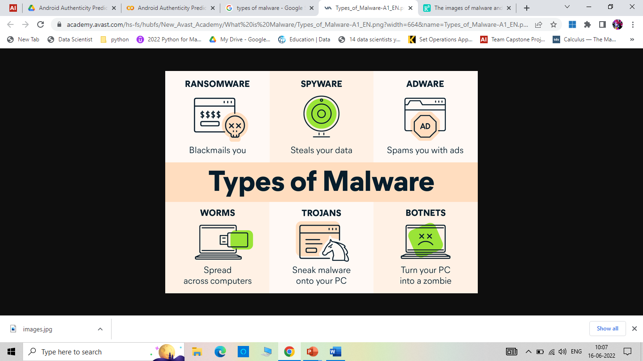
Types of Malware

Slide 6
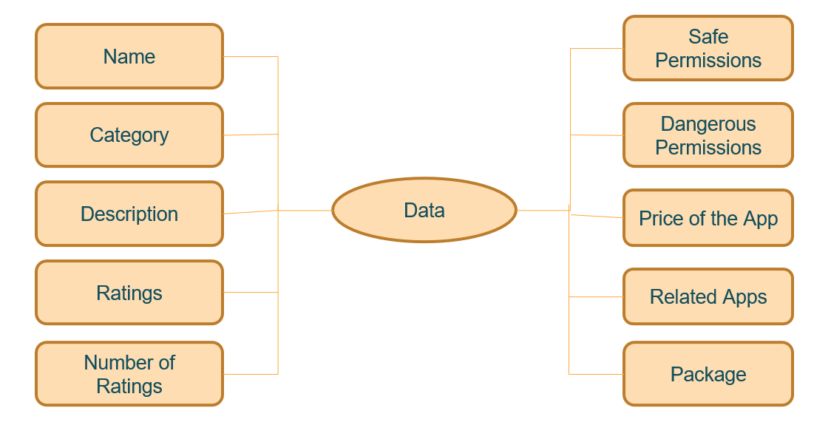
Data Summary

Slide 7
Data Preprocessing and Feature Selection
Handled the null values by imputing some of the values and dropping those values which can’t be imputed.
Drop the duplicates to avoid bias before data modelling.
Checking the correlation between various features.
Feature Selection that is removing the variables which were constant that is were not positively contributing to the modelling and the one which were not of that importance.

Slide 8

Exploratory Data Analysis
Explored the data for better understanding the distribution of the features, their statistical values, relationship between them and with the class labels using matplotlib, seaborn and pandas library.

Slide 9
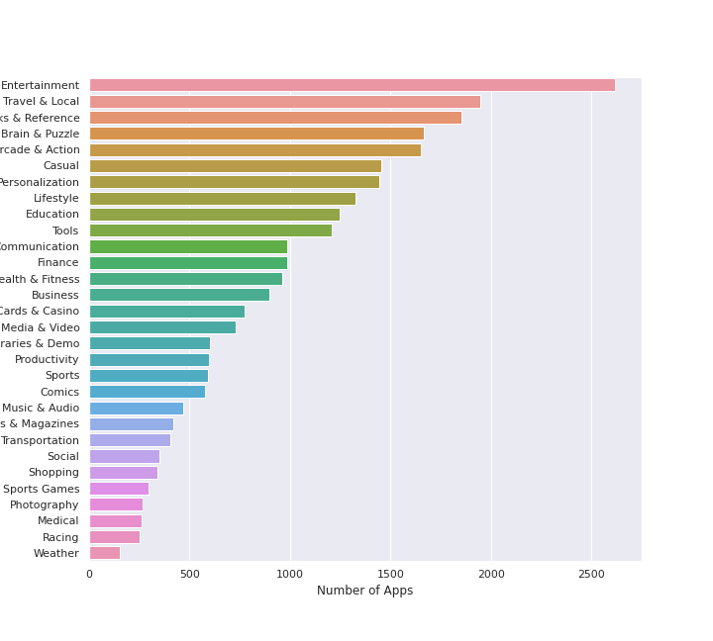
Category of the Apps

Slide 10
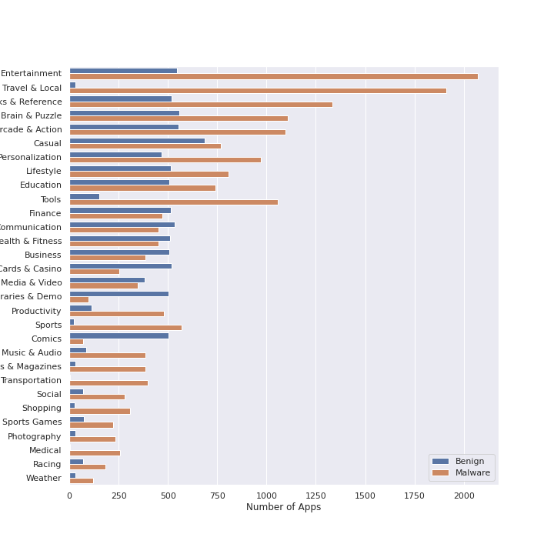
Category of Apps and their malware Status
Most of the entertainment Apps are malware Apps. But, in terms of percentage, it seems more than 95% of Travelling apps, Sports, Magazines, Medical and Transportation apps are culprit as per this dataset.

Slide 11
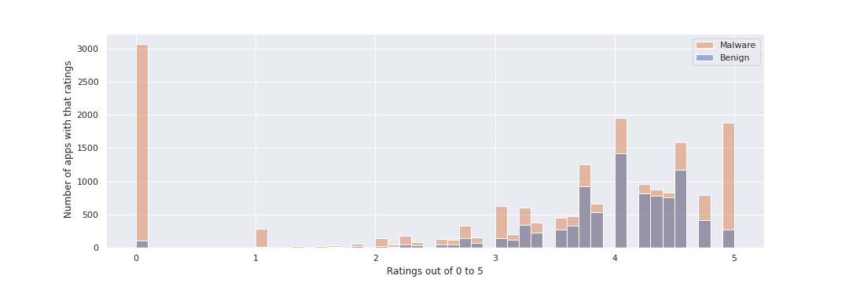
Ratings and the malware Status
Most of the malware apps seems to have ratings as 0, but there are many instances of 5 ratings too. So, we can say the ratings distribution is neither symmetric nor skewed.

Slide 12
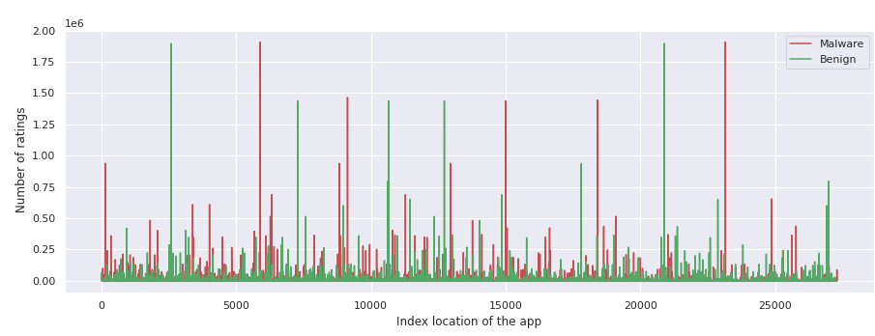
Number of Ratings
Number of ratings are randomly distributed. Most of the apps ratings are less than 250 thousands but many have ratings in millions too.

Slide 13
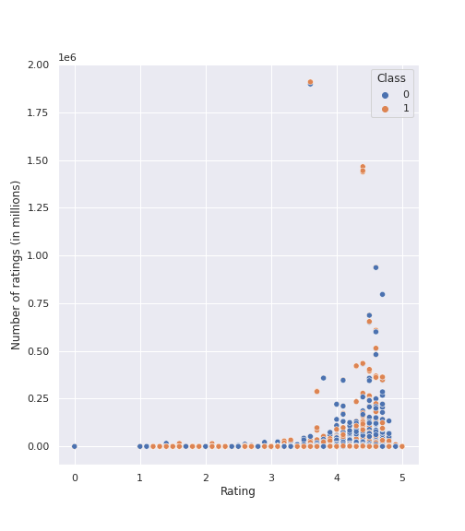
Ratings and Number of Ratings
No clear cut distinction for malware and benign apps.
Overlapped instances of different classes
Scatter plot is positively skewed.

Slide 14
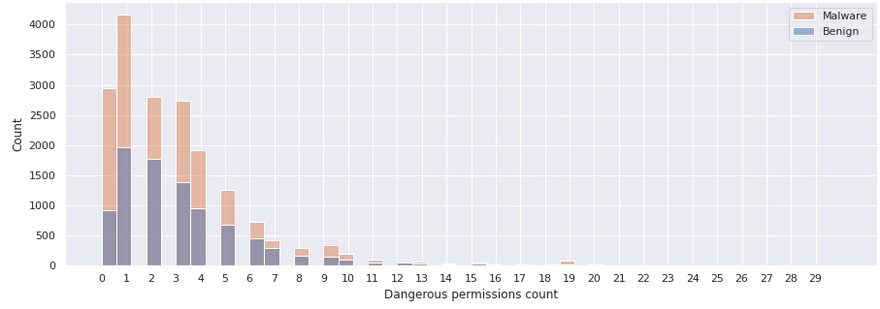
Number of Dangerous Permissions and the class
Dangerous permissions are negatively skewed. Very less number of apps have dangerous permissions more than 7. The 0 and 1 permissions for malware apps is a sign of the masked behavior of the culprits.

Slide 15
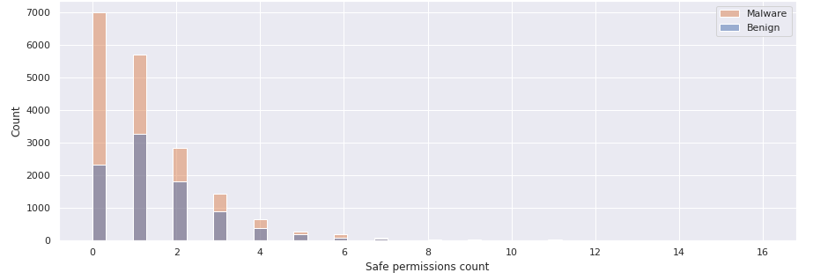
Number of Safe Permissions and the class
Most of the apps take very few safe permissions in fact lower than 5.

Slide 16
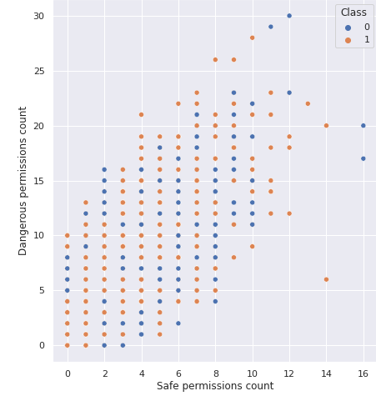
Number of Safe Permissions and Dangerous permissions
There seems no relationship between number of safe permissions or dangerous permissions an app take and the class of the app.

Slide 17
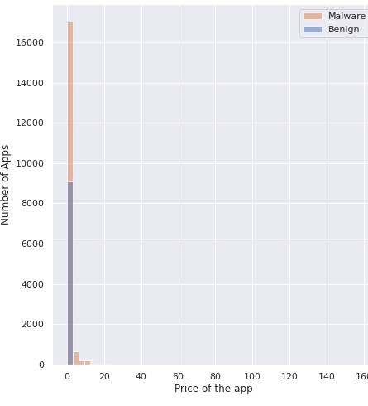
Price of the app
During Analysis, we found that the apps with price more than zero are all malware apps that is it could be a great differentiator for this dataset but not valid for all. Thus, couldn’t use Decision Tree Classifier for modelling.

Slide 18
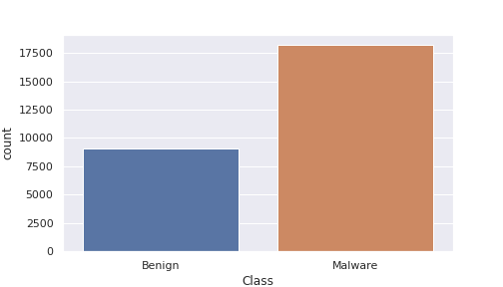
Class Distribution
Data is moderately imbalanced with 66:33 ratio.

Slide 19
Data Preparation for modelling
Encoding Categorical Variables: We used One Hot Encoder from sklearn library of python, which creates a unique feature per unique entry of the category column.
Splitting Data: Given problem was the supervised Classification problem. Thus, it was possible for us to evaluate the model. So, we split the data using Train- Test split so that we could check the performance of our model before finalizing the model on unseen data.

Slide 20
Continued..
Feature Scaling: Some of the Algorithms which we were going to used were distance-based Algorithms and since the scale of the features were different. We have to bring them to equal level to give equal weightage. There are many Scaling Algorithms inbuilt in sklearn library like Minmax Scaler, Standard Scaler. We used Standard Scaler which transform the continuous variables into Standard Normal Distribution.

Slide 21
Applying model
Since the features were not in linear relationship with the class variable, we didn’t go for Logistic Regression
Price was a great distinguisher between the classes. So, we decided to not to use Decision Classifier as it would create a bias.
Decided to go with other tree based classifiers like Random Forest, Gradient Boosting since they work on the principle of ensemble.
Other classifier models used are SVM, Naïve Bayes and KNN.

Slide 22
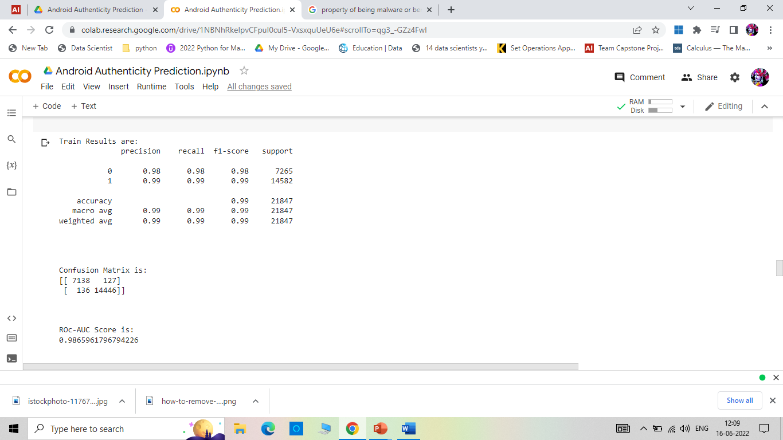
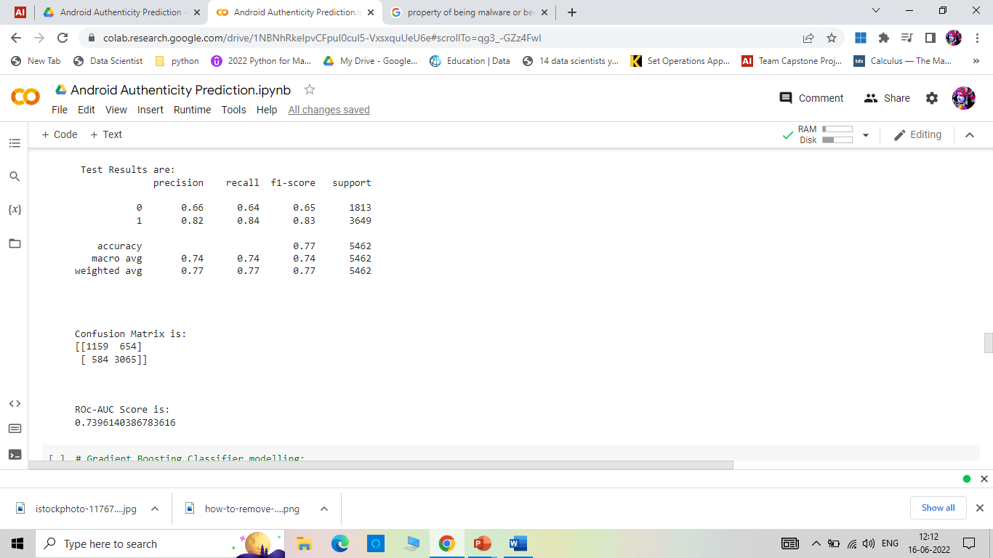
Random Forest model:
It seems that Random Forest is overfitting the data as train data results are far better than test data.

Slide 23


Gradient boosting model:

Slide 24
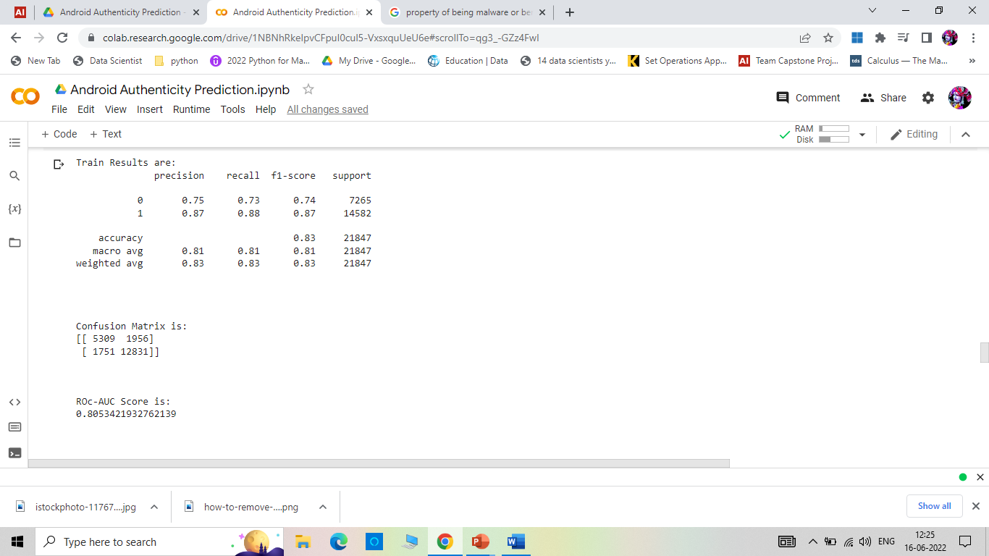
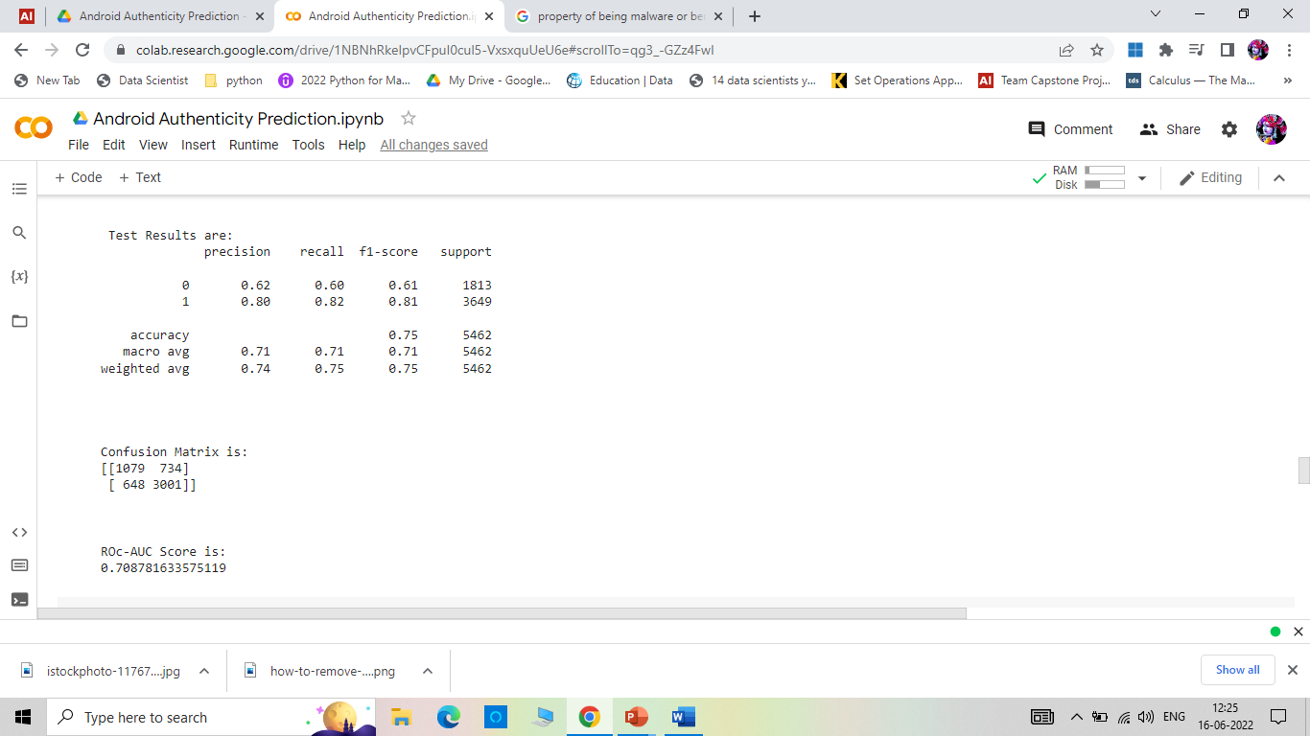
KNN Classifier

Slide 25


SVM Model

Slide 26


Naïve Bayes Model
Naïve Bayes is not performing well comparing to other Classifier models we used.

Slide 27
Cross-validation and hyperparameter Tuning:
Used GridSearchCV for hyperparameter tuning and cross-validation
Applied it on three models which were showing better performances:
KNN
Random Forest
Gradient Boosting

Slide 28
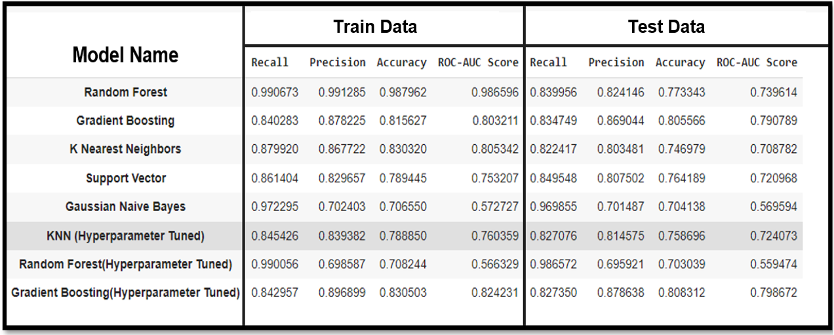
Evaluation Metrics after Tuning the models

Slide 29
Final Model Selection
Final model decided on the basis of Recall and Precision.
Recall is the ratio of number of positives predicted to the total positives.
The model has recall of 0.84 that is it is able to detect 84% of the malware apps.
The overall accuracy is 83% of train model and 80% on the test model.

Slide 30
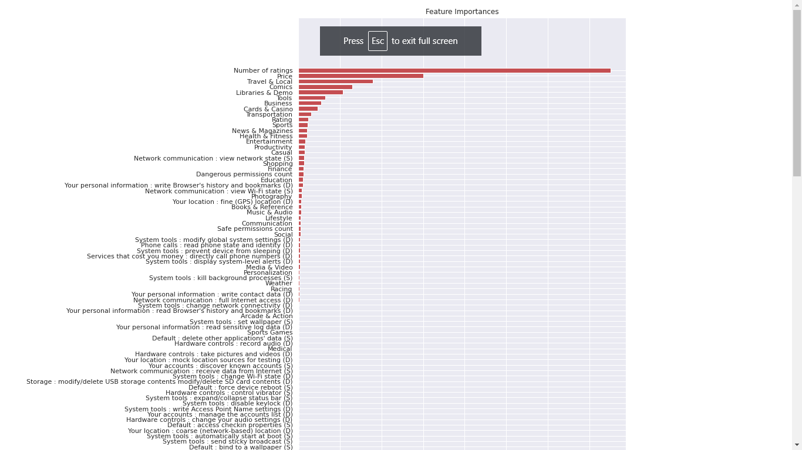
Feature importance in final model

Slide 31
Thank You

